Slide 1
Introduction to HTML

Slide 2
HTML is the language used to create webpages.
HTML stands for Hypertext Markup Language.
HTML documents written with this text (or coding) tell browsers how to interpret and display the data.

Slide 3
HTML documents can be identified by the file extension .htm or .html.
HTML standards are set and maintained by an international group of industry leaders such as Microsoft and Apple, called The World Wide Web Consortium (W3C).

Slide 4
The rules that govern how HTML is written are called syntax.
As new Web technologies emerge, HTML evolves through the W3C with newer versions such as HTML5.0 that introduced new standards

Slide 5
New in HTML5
There are many changes to HTML5 that make it much easier to work with.
The semantics and structure are clearer and more straight forward than previous versions of HTML.
New Elements have been added and redundant Tags have been removed.

Slide 6
New in HTML5
The insertion of media has been streamlined and it has been updated to work across a multitude of platforms, i.e. home computers, tablets and mobile phones.

Slide 7
The “Markup Language” component of HTML refers to the insertion of instructions, called tags.
Tags tell the Web browser how to interpret the data.
Tags follow a standard format. Each tag begins with a “less than” symbol (<), immediately followed by the tag text, and ending in a “greater than” symbol (>).

Slide 8
Spelling is critical, as tags not recognized by a Web browser are ignored.
Tags in HTML can be written in either upper or lowercase.
However, it is considered generally good practice to type your tags in lower case.

Slide 9
Tag Example: <body>
Most tags have a similar counterpart, called an “end tag” which stops the effect of the tag.
An end tag is identical to the start tag counterpart, but also includes a forward slash “/” immediately before the tag text.
Some tags do not have a closing counterpart, such as the Image tag (<img>). A closing tag must always include the forward slash “/”. End Tag Example:</body>

Slide 10
Choosing Text Editor
There are many different programs that you can use to create web documents.
HTML Editors enable users to create documents quickly and easily by pushing a few buttons. Instead of entering all of the HTML codes by hand.
These programs will generate the HTML Source Code for you.

Slide 11
Choosing Text Editor
HTML Editors are excellent tools for experienced web developers; however; it is important that you learn and understand the HTML language so that you can edit code and fix “bugs” in your pages.
It’s advisable to focus on using the standard Microsoft Windows text editors, NotePad. We may use also textpad.

Slide 12
Starting NotePad
NotePad is the standard text editor that comes with the microsoft windows operating system. To start NotePad in windows 9x or XP follow the steps bellow:
Click on the “Start” button located on your Windows task bar.
Click on “Programs” and then click on the directory menu labeled “Accessories”.
Locate the shortcut “NotePad” and click the shortcut once.

Slide 13
HTML Page Creation & Editing
In this chapter you will learn to create HTML
pages with a standard text editor.
Objectives
Upon completing this section, you should be able to
1. Choose a Text Editor.
2. Create a Basic Starting Document.
3. Understand and set Document Properties.
4. View Your Results in a Browser.

Slide 14
Creating a Basic Starting Document
<HTML>
<HEAD>
<TITLE>VIT University</TITLE>
</HEAD>
<BODY>
This is what is displayed.
</BODY>
</HTML>
Notes:
09/22/97
9
University of Minnesota Extension Service
Master Internet Volunteer Program
Tech help should be a local or toll-free call
Is it available when you are using the net?
Will you get a real person or have to leave voice mail? (voice mail is OK if the response time is fast and during a time you are not connected)
Try calling tech support before subscribing.

Slide 15
Creating a Basic Starting Document
The HEAD of your document point to above window part. The TITLE of your document appears in the very top line of the user’s browser. If the user chooses to “Bookmark” your page or save as a “Favorite”; it is the TITLE that is added to the list.
The text in your TITLE should be as descriptive as possible because this is what many search engines, on the internet, use for indexing your site.

Slide 16
Setting Document Properties
Document properties are controlled by attributes of the BODY element. For example, there are color settings for the background color of the page, the document’s text and different states of links.

Slide 17
Color Codes
Colors are set using “RGB” color codes, which are, represented as hexadecimal values. Each 2-digit section of the code represents the amount, in sequence, of red, green or blue that forms the color. For example, a RGB value with 00 as the first two digits has no red in the color.

Slide 18

Main Colours

Slide 19
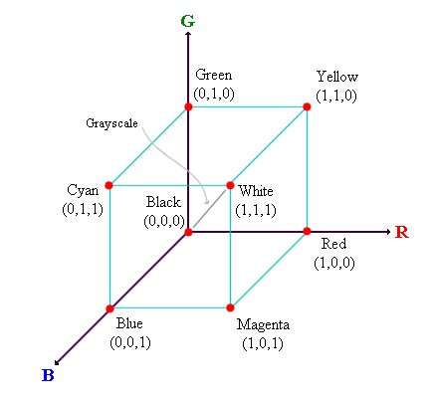
RGB Colour Model

Slide 20
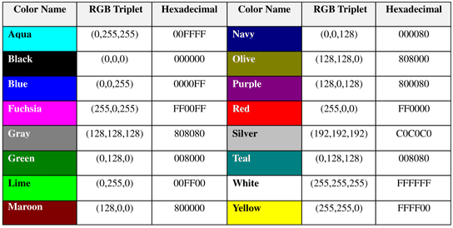
16 Basic Colors

Slide 21
Color Codes
WHITE
BLACK
RED
GREEN
BLUE
MAGENTA
CYAN
YELLOW
AQUAMARINE
BAKER’S CHOCOLATE
VIOLET
BRASS
COPPER
PINK
ORANGE
#FFFFFF
#000000
#FF0000
#00FF00
#0000FF
#FF00FF
#00FFFF
#FFFF00
#70DB93
#5C3317
#9F5F9F
#B5A642
#B87333
#FF6EC7
#FF7F00

Slide 22
Color Codes
If you require more information about color values, there is an excellent site entitled “VGDesign’s Interactive Color Cube” that displays the background color code when you put your cursor over a small color sample. The Web address is :
http://www.vgdesign.com/color.html

Slide 23
The Body Element
The BODY element of a web page is an important element in regards to the page’s appearance. Here are the attributes of the BODY tag to control all the levels:
TEXT="#RRGGBB" to change the color of all the text on the page (full page text color.)
This element contains information about the page’s background color, the background image, as well as the text and link colors.

Slide 24
Background Color
It is very common to see web pages with their background color set to white or some other colors.
To set your document’s background color, you need to edit the <BODY> element by adding the BGCOLOR attribute. The following example will display a document with a white background color:
<BODY BGCOLOR=“#FFFFFF”></BODY>

Slide 25
TEXT Color
The TEXT attribute is used to control the color of all the normal text in the document. The default color for text is black. The TEXT attribute would be added as follows:
<BODY BGCOLOR=“#FFFFFF” TEXT=“#FF0000”></BODY>
In this example the document’s page
color is white and the text would be red.

Slide 26
LINK, VLINK, and ALINK
These attributes control the colors of the different link states:
1. LINK – initial appearance – default = Blue.
2. VLINK – visited link – default = Purple.
3. ALINK –active link being clicked–default= Yellow.
The Format for setting these attributes is:
<BODY BGCOLOR=“#FFFFFF” TEXT=“#FF0000” LINK=“#0000FF”
VLINK=“#FF00FF”
ALINK=“FFFF00”> </BODY>

Slide 27
Using Image Background
The BODY element also gives you ability of setting an image as the document’s background.
An example of a background image’s HTML code is as follows:
<BODY BACKGROUND=“hi.gif” BGCOLOR=“#FFFFFF”></BODY>

Slide 28
Previewing Your Work
Once you have created your basic starting document and set your document properties it is a good idea to save your file.
To save a file, in NotePad, follow these steps:
Locate and click on the menu called “File”.
Select the option under File Menu labeled “Save As”.
In the “File Name” text box, type in the entire name of your file (including the extension name .html).

Slide 29
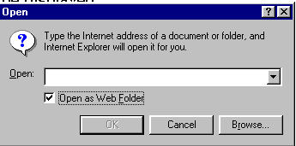
Edit, Save and View Cycle
To preview Your Work, open a web browser and do the following:
Click on the menu labeled “File”.
Locate the menu option, “Open”.

Slide 30
Edit, Save and View Cycle
In the “Open” dialog box, click on the “Browse” button and locate your web document.
Click “OK” once you have selected your file.
The web browser will load the same document but with the new revisions. This process is the Edit, Save and View Cycle.

Slide 31
Headings, Paragraphs, Breaks & Horizontal Rules
In this chapter you will add headings to your page, insert paragraphs, add some breaks, and add horizontal rules.
Objectives
Upon completing this section, you should be able to
List and describe the different Heading elements.
Use Paragraphs to add text to a document.
Insert breaks where necessary.
Add a Horizontal Rule.

Slide 32
Headings, <Hx> </Hx>
Inside the BODY element, heading elements H1 through H6 are generally used for major divisions of the document. Headings are permitted to appear in any order, but you will obtain the best results when your documents are displayed in a browser if you follow these guidelines:
H1: should be used as the highest level of heading, H2 as the next highest, and so forth.
You should not skip heading levels: e.g., an H3 should not appear after an H1, unless there is an H2 between them.

Slide 33
Headings, <Hx> </Hx>
<HTML>
<HEAD>
<TITLE> Example Page</TITLE>
</HEAD>
<BODY>
<H1> Heading 1 </H1>
<H2> Heading 2 </H2>
<H3> Heading 3 </H3>
<H4> Heading 4 </H4>
<H5> Heading 5 </H5>
<H6> Heading 6 </H6>
</BODY>
</HTML>
Heading 1
Heading 2
Heading 3
Heading 4
Heading 5
Heading 6

Slide 34
Paragraphs, <P> </P>
Paragraphs allow you to add text to a document in such a way that it will automatically adjust the end of line to suite the window size of the browser in which it is being displayed. Each line of text will stretch the entire length of the window.

Slide 35
Paragraphs, <P> </P>
<HTML><HEAD>
<TITLE> Example Page</TITLE>
</HEAD>
<BODY></H1> Heading 1 </H1>
<P> Paragraph 1, ….</P>
<H2> Heading 2 </H2>
<P> Paragraph 2, ….</P>
<H3> Heading 3 </H3>
<P> Paragraph 3, ….</P>
<H4> Heading 4 </H4>
<P> Paragraph 4, ….</P>
<H5> Heading 5 </H5>
<P> Paragraph 5, ….</P>
<H6> Heading 6</H6>
<P> Paragraph 6, ….</P>
</BODY></HTML>
Heading 1
Paragraph 1,….
Heading 2
Paragraph 2,….
Heading 3
Paragraph 3,….
Heading 4
Paragraph 4,….
Heading 5
Paragraph 5,….
Heading 6
Paragraph 6,….

Slide 36
Break, <BR>
Line breaks allow you to decide where the text will break on a line or continue to the end of the window.
A <BR> is an empty Element, meaning that it may contain attributes but it does not contain content.
The <BR> element does not have a closing tag.

Slide 37
Break, <BR>
<HTML>
<HEAD>
<TITLE> Example Page</TITLE>
</HEAD>
<BODY>
<H1> Heading 1 </H1>
<P>Paragraph 1, <BR>
Line 2 <BR> Line 3 <BR>….
</P>
</BODY>
</HTML>
Heading 1
Paragraph 1,….
Line 2
Line 3
….

Slide 38
Horizontal Rule, <HR>
The <HR> element causes the browser to display a horizontal line (rule) in your document.
<HR> does not use a closing tag, </HR>.

Slide 39
Horizontal Rule, <HR>
Attribute | Description | Default Value
SIZE | Height of the rule in pixels | 2 pixels
WIDTH | Width of the rule in pixels or percentage of screen width | 100%
NOSHADE | Draw the rule with a flat look instead of a 3D look | Not set (3D look)
ALIGN | Aligns the line (Left, Center, Right) | Center
COLOR | Sets a color for the rule (IE 3.0 or later) | Not set

Slide 40
Horizontal Rule, <HR>
<HTML>
<HEAD>
<TITLE> Example Page</TITLE>
</HEAD>
<BODY>
<H1> Heading 1 </H1>
<P>Paragraph 1, <BR>
Line 2 <BR>
<HR>Line 3 <BR>
</P>
</BODY>
</HTML>
Heading 1
Paragraph 1,….
Line 2
___________________________
Line 3

Slide 41
Character Formatting
In this chapter you will learn how to enhance your page with Bold, Italics, and other character formatting options.
Objectives
Upon completing this section, you should be able to
Change the color and size of your text.
Use Common Character Formatting Elements.
Align your text.
Add special characters.
Use other character formatting elements.

Slide 42
Bold, Italic and other Character Formatting Elements
<FONT SIZE=“+2”> Two sizes bigger</FONT>
The size attribute can be set as an absolute value from 1 to 7 or as a relative value using the “+” or “-” sign. Normal text size is 3 (from -2 to +4).
<B> Bold </B>
<I> Italic </I>
<U> Underline </U>
Color = “#RRGGBB” The COLOR attribute of the FONT element. E.g., <FONT COLOR=“#RRGGBB”>this text has color</FONT>
<PRE> Preformatted </PRE> Text enclosed by PRE tags is displayed in a mono-spaced font. Spaces and line breaks are supported without additional elements or special characters.

Slide 43
Bold, Italic and other Character Formatting Elements
<EM> Emphasis </EM> Browsers usually display this as italics.
<STRONG> STRONG </STRONG> Browsers display this as bold.
<TT> TELETYPE </TT> Text is displayed in a mono-spaced font. A typewriter text, e.g. fixed-width font.
<CITE> Citation </CITE> represents a document citation (italics). For titles of books, films, etc. Typically displayed in italics. (A Beginner's Guide to HTML)

Slide 44
Bold, Italic and other Character Formatting Elements
<P> <FONT SIZE=“+1”> One Size Larger </FONT> - Normal –
<FONT SIZE=“-1”> One Size Smaller </FONT> <BR>
<B> Bold</B> - <I> italics</I> - <U> Underlined </U> -
<FONT COLOR=“#FF0000”> Colored </FONT> <BR>
<EM> Emphasized</EM> - <STRONG> Strong </STRONG> - <TT> Tele Type </TT> <BR>
One Size Larger - Normal – One Size Smaller Bold - italics - Underlined - Colored Emphasized - Strong - Tele Type

Slide 45
Alignment
Some elements have attributes for alignment (ALIGN) e.g. Headings, Paragraphs and Horizontal Rules.
The Three alignment values are : LEFT, RIGHT, CENTER.
<CENTER></CENTER> Will center elements.

Slide 46
Alignment
<DIV ALIGN=“value”></DIV> Represents a division in the document and can contain most other element type. The alignment attribute of the DIV element is well supported.
<TABLE></TABLE> Inside a TABLE, alignment can be set for each individual cell.

Slide 47
Special Characters & Symbols
These Characters are recognized in HTML as they begin with an ampersand and end with with a semi-colon e.g. &value; The value will either be an entity name or a standard ASCII character number. They are called escape sequences.
The next table represents some of the more commonly used special characters. For a comprehensive listing, visit the W3C’s section on special characters at: http://www.w3.org/MarkUp/HTMLPlus/htmlplus_13.html

Slide 48
Special Characters & Symbols
Special Character | Entity Name | Special Character | Entity Name
Ampersand | &amp; & | Greater-than sign | &gt; >
Asterisk | &lowast; ∗∗ | Less-than sign | &lt; <
Cent sign | &cent; ¢ | Non-breaking space | &nbsp;
Copyright | &copy; © | Quotation mark | &quot; "
Fraction one qtr | &frac14; ¼ | Registration mark | &reg; ®
Fraction one half | &frac12; ½ | Trademark sign | &trade; ™

Slide 49
Special Characters & Symbols
Additional escape sequences support accented characters, such as:
&ouml;
a lowercase o with an umlaut: ö
&ntilde;
a lowercase n with a tilde: ñ
&Egrave;
an uppercase E with a grave accent: È
NOTE: Unlike the rest of HTML, the escape sequences are case sensitive. You cannot, for instance, use &LT; instead of &lt;.

Slide 50
Additional Character Formatting Elements
<STRIKE> strike-through text</STRIKE>
DEL is used for STRIKE at the latest browsers
<BIG> places text in a big font</BIG>
<SMALL> places text in a small font</SMALL>
<SUB> places text in subscript position </SUB>
<SUP> places text in superscript style position </SUP>

Slide 51
Example
<P><STRIKE> strike-through text </STRIKE></BR>
<BIG>places text in a big font </BIG><BR>
<SMALL> places text in a small font</SMALL><BR>
<SUB> places text in subscript position </SUB>
Normal
<SUP> places text in superscript style position </SUP><BR> </P>

Slide 52
Lists
In this chapter you will learn how to create a variety of lists.
Objectives
Upon completing this section, you should be able to
Create an unordered list.
Create an ordered list.
Create a defined list.
Nest Lists.

Slide 53
List Elements
HTML supplies several list elements. Most list elements are composed of one or more <LI> (List Item) elements.
UL : Unordered List. Items in this list start with a list mark such as a bullet. Browsers will usually change the list mark in nested lists.
<UL>
<LI> List item …</LI>
<LI> List item …</LI>
</UL>
List item …
List item …

Slide 54
List Elements
You have the choice of three bullet types: disc(default), circle, square.
These are controlled in Netscape Navigator by the “TYPE” attribute for the <UL> element.
<UL TYPE=“square”>
<LI> List item …</LI>
<LI> List item …</LI>
<LI> List item …</LI>
</UL>
List item …
List item …
List item …

Slide 55
List Elements
OL: Ordered List. Items in this list are numbered automatically by the browser.
<OL>
<LI> List item …</LI>
<LI> List item …</LI>
<LI> List item …</LI>
</OL>
List item …
List item …
List item
You have the choice of setting the TYPE Attribute to one of five numbering styles.

Slide 56
List Elements
TYPE | Numbering | Styles
1 | Arabic numbers | 1,2,3, ……
a | Lower alpha | a, b, c, ……
A | Upper alpha | A, B, C, ……
i | Lower roman | i, ii, iii, ……
I | Upper roman | I, II, III, ……

Slide 57
List Elements
You can specify a starting number for an ordered list.
<OL TYPE =“i”>
<LI> List item …</LI>
<LI> List item …</LI>
</OL>
<P> text ….</P>
<OL TYPE=“i” START=“3”>
<LI> List item …</LI>
</OL>

Slide 58
List Elements
List item …
List item …
Text ….
List item …

Slide 59
List Elements
DL: Definition List. This kind of list is different from the others. Each item in a DL consists of one or more Definition Terms (DT elements), followed by one or more Definition Description (DD elements).
<DL>
<DT> HTML </DT>
<DD> Hyper Text Markup Language </DD>
<DT> DOG </DT>
<DD> A human’s best friend!</DD>
</DL>
HTML
Hyper Text Markup Language
DOG
A human’s best friend!

Slide 60
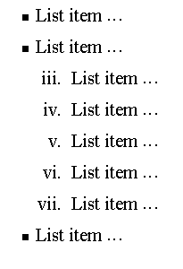
Nesting Lists
You can nest lists by inserting a UL, OL, etc., inside a list item (LI).
EXample
<UL TYPE = “square”>
<LI> List item …</LI>
<LI> List item …
<OL TYPE=“i” START=“3”>
<LI> List item …</LI>
<LI> List item …</LI>
<LI> List item …</LI>
<LI> List item …</LI>
<LI> List item …</LI>
</OL>
</LI>
<LI> List item …</LI>
</UL>

Slide 61
What will be the output?
<H1 ALIGN="CENTER">SAFETY TIPS FOR CANOEISTS</H1> <OL TYPE=“a” START=“2”> <LI>Be able to swim </LI> <LI>Wear a life jacket at all times </LI> <LI>Don't stand up or move around. If canoe tips,
<UL> <LI>Hang on to the canoe </LI> <LI>Use the canoe for support and </LI> <LI>Swim to shore </UL> </LI>
<LI>Don't overexert yourself </LI> <LI>Use a bow light at night </LI> </OL>

Slide 62
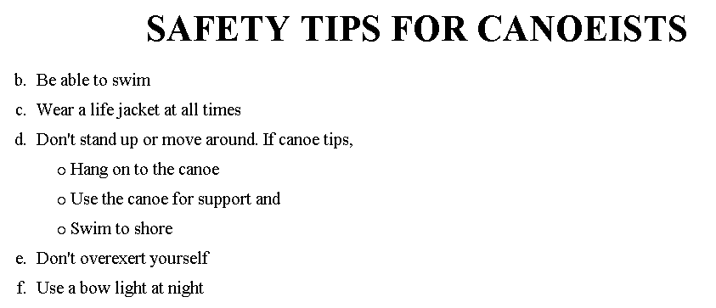
The output….

Slide 63
<H1 ALIGN="CENTER">SAFETY TIPS FOR CANOEISTS</H1>
<OL TYPE="a" START="2">
<LI>Be able to swim </LI>
<LI>Wear a life jacket at all times </LI>
<LI>Don't stand up or move around. If canoe tips,
<UL>
<LI>Hang on to the canoe </LI>
<LI>Use the canoe for support
<OL type="I" start="4">
<LI> Be careful </LI>
<LI> Do not look around</LI>
</LI> </OL>
<LI>Swim to shore
</UL> </LI>
<LI>Don't overexert yourself </LI>
<LI>Use a bow light at night </LI>
</OL>
What
will
be the
output?

Slide 64
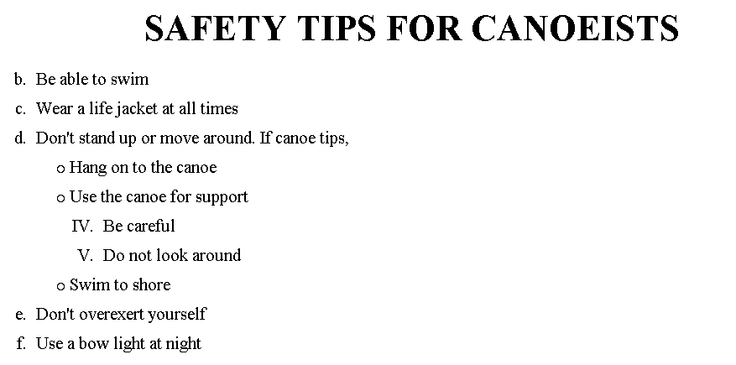
The output….

Slide 65
Images
In this chapter you will learn about images and how to place images in your pages.
Objectives
Upon completing this section, you should be able to
Add images to your pages.

Slide 66
Images
<IMG>This element defines a graphic image on the page.
Image File (SRC:source): This value will be a URL (location of the image) E.g. http://www.domain.com/dir/file.ext or /dir/file.txt.
Alternate Text (ALT): This is a text field that describes an image or acts as a label. It is displayed when they position the cursor over a graphic image.
Alignment (ALIGN): This allows you to align the image on your page.

Slide 67
Images
Width (WIDTH): is the width of the image in pixels.
Height (HEIGHT): is the height of the image in pixels.
Border (BORDER): is for a border around the image, specified in pixels.
HSPACE: is for Horizontal Space on both sides of the image specified in pixels. A setting of 5 will put 5 pixels of invisible space on both sides of the image.
VSPACE: is for Vertical Space on top and bottom of the image specified in pixels. A setting of 5 will put 5 pixels of invisible space above and bellow the image.

Slide 68
Some Examples on images
1) <IMG SRC=“jordan.gif“ border=4>
2) <IMG SRC=" jordan.gif" width="60" height="60">
3) <IMG SRC=“jordan.gif" ALT="This is a text that goes with the image">
4) <IMG SRC=" jordan.gif “ Hspace="30" Vspace="10" border=20>
5) < IMG SRC =" jordan.gif“ align="left">
blast blast blast blast blast

Slide 69
Anchors, URLs and Image Maps
In this chapter you will learn about Uniform Resource Locator, and how to add them as Anchor or Links inside your web pages.
Objectives
Upon completing this section, you should be able to
Insert links into documents.
Define Link Types.
Define URL.
List some commonly used URLs.
Plan an Image Map.

Slide 70
HOW TO MAKE A LINK
1) The tags used to produce links are the <A>
and </A>. The <A> tells where the link should start and
the </A> indicates where the link ends. Everything between
these two will work as a link.
2) The example below shows how to make the word
Here work as a link to yahoo.
Click <A HREF="http://www.yahoo.com">here</A> to
go to yahoo.

Slide 71
More on LINKs
<body LINK="#C0C0C0" VLINK="#808080" ALINK="#FF0000">
LINK - standard link - to a page the visitor hasn't been to yet. (standard color is blue - #0000FF). VLINK - visited link - to a page the visitor has been to before. (standard color is purple - #800080). ALINK - active link - the color of the link when the mouse is on it. (standard color is red - #FF0000).
If the programmer what to change the color
Click <a href="http://www.yahoo.com"><font color="FF00CC">here</font></a> to go to yahoo.

Slide 72
Internal Links
Internal Links : Links can also be created inside large documents to simplify navigation. Today’s world wants to be able to get the information quickly. Internal links can help you meet these goals.
Select some text at a place in the document that you would like to create a link to, then add an anchor to link to like this:
<A NAME=“bookmark_name”></A>
The Name attribute of an anchor element specifies a location in the document that we link to shortly. All NAME attributes in a document must be unique.
Next select the text that you would like to create as a link to the location created above.
<A HREF=“#bookmark_name”>Go To Book Mark</A>

Slide 73
E-Mail (Electronic Mail)
E.g. mailto:kmf@yahoo.com
The type of service is identified as the mail client program. This type of link will launch the users mail client.
The recipient of the message is kmf@yahoo.com
<A HREF=“mailto:kmf@yahoo.com”>Send me
More Information </A>

Slide 74
Image Maps
Image maps are images, usually in gif format that have been divided into regions; clicking in a region of the image cause the web surfer to be connected to a new URL. Image maps are graphical form of creating links between pages.
There are two type of image maps:
Client side and server side
Both types of image maps involve a listing of co-ordinates
that define the mapping regions and which URLs those
coordinates are associated with. This is known as the map
file.

Slide 75
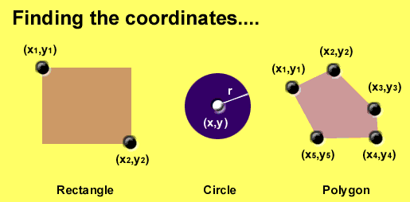
Area Shapes Used

Slide 76
Client-Side Image Maps
Client-side image maps (USEMAP) use a map file that is part of the HTML document (in an element called MAP), and is linked to the image by the Web browser.
<IMG SRC="note.GIF" Width=200 Height=200
border="5" USEMAP="#map1">
<MAP NAME="map1">
<AREA SHAPE="RECT" COORDS="0,0,90,90"
HREF="hi.html" ALT="see me…">
<AREA SHAPE="RECT" COORDS="100,100,160,160"
HREF="divPara.html" ALT="see him…" >
<AREA SHAPE="CIRCLE" COORDS="150,50,20"
HREF="house.html" ALT="see it…" >
</MAP>
We can use Poly as well as Rect……

Slide 77
Shapes, Coords
Types of Shapes
Rect → used for squares and ordered shapes.
Circle → used for circles.
Poly → used for unordered shapes.
Number of coordenations for each shape:
Rect →4 numbers for two corners
Circle →3 numbers for the center & R
Poly → depends on the number of corners of the shape( 2 numbers for each corner)

Slide 78
Tables
In this chapter you will learn that tables have many uses in
HTML.
Objectives:
Upon completing this section, you should be able to:
Insert a table.
Explain a table’s attributes.
Edit a table.
Add a table header.

Slide 79
Tables
The <TABLE></TABLE> element has four sub-elements:
Table Row<TR></TR>.
Table Header <TH></TH>.
Table Data <TD></TD>.
Caption <CAPTION></CAPTION>.
The table row elements usually contain table header elements or table data elements.

Slide 80
Tables
<table border=“1”>
<tr>
<th> Column 1 header </th>
<th> Column 2 header </th>
</tr>
<tr>
<td> Row1, Col1 </td>
<td> Row1, Col2 </td>
</tr>
<tr>
<td> Row2, Col1 </td>
<td> Row2, Col2 </td>
</tr>
</table>

Slide 81
Tables
Column 1 Header | Column 2 Header
Row1, Col1 | Row1, Col2
Row2, Col1 | Row2, Col2

Slide 82
Tables Attributes
BGColor: Some browsers support background colors in a table.
Width: you can specify the table width as an absolute number of pixels or a percentage of the document width. You can set the width for the table cells as well.
Border: You can choose a numerical value for the border width, which specifies the border in pixels.
CellSpacing: Cell Spacing represents the space between cells and is specified in pixels.

Slide 83
Table Attributes
CellPadding: Cell Padding is the space between the cell border and the cell contents and is specified in pixels.
Align: tables can have left, right, or center alignment.
Background: Background Image, will be titled in IE3.0 and above.
BorderColor, BorderColorDark.

Slide 84
Table Caption
A table caption allows you to specify a line of text that will appear centered above or bellow the table.
<TABLE BORDER=1 CELLPADDING=2>
<CAPTION ALIGN=“BOTTOM”> Label For My Table </CAPTION>
The Caption element has one attribute ALIGN that can be either TOP (Above the table) or BOTTOM (below the table).

Slide 85
Table Header
Table Data cells are represented by the TD element. Cells can also be TH (Table Header) elements which results in the contents of the table header cells appearing centered and in bold text.

Slide 86
Table Data and Table Header Attributes
Colspan: Specifies how many cell columns of the table this cell should span.
Rowspan: Specifies how many cell rows of the table this cell should span.
Align: cell data can have left, right, or center alignment.
Valign: cell data can have top, middle, or bottom alignment.
Width: you can specify the width as an absolute number of pixels or a percentage of the document width.
Height: You can specify the height as an absolute number of pixels or a percentage of the document height.

Slide 87
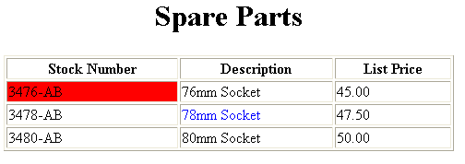
Basic Table Code
<TABLE BORDER=1 width=50%>
<CAPTION> <h1>Spare Parts <h1> </Caption>
<TR><TH>Stock Number</TH><TH>Description</TH><TH>List Price</TH></TR>
<TR><TD bgcolor=red>3476-AB</TD><TD>76mm Socket</TD><TD>45.00</TD></TR>
<TR><TD >3478-AB</TD><TD><font color=blue>78mm Socket</font> </TD><TD>47.50</TD></TR>
<TR><TD>3480-AB</TD><TD>80mm Socket</TD><TD>50.00</TD></TR>
</TABLE>

Slide 88
Table Data and Table Header Attributes
<Table border=1 cellpadding =2>
<tr> <th> Column 1 Header</th> <th> Column 2 Header</th> </tr>
<tr> <td colspan=2> Row 1 Col 1</td> </tr>
<tr> <td rowspan=2>Row 2 Col 1</td>
<td> Row 2 Col2</td> </tr>
<tr> <td> Row 3 Col2</td> </tr>
</table>

Slide 89
Table Data and Table Header Attributes
Column 1 Header | Column 2 Header
Row 1 Col 1
Row 2 Col 1 | Row 2 Col 2
 | Row 3 Col 2

Slide 90
Special Things to Note
TH, TD and TR should always have end tags. Although the end tags are formally optional, many browsers will mess up the formatting of the table if you omit the end tags. In particular, you should always use end tags if you have a TABLE within a TABLE -- in this situation, the table parser gets hopelessly confused if you don't close your TH, TD and TR elements.
A default TABLE has no borders By default, tables are drawn without border lines. You need the BORDER attribute to draw the lines.
By default, a table is flush with the left margin TABLEs are plopped over on the left margin. If you want centered tables, You can either: place the table inside a DIV element with attribute ALIGN="center". Most current browsers also supports table alignment, using the ALIGN attribute. Allowed values are "left", "right", or "center", for example: <TABLE ALIGN="left">. The values "left" and "right" float the table to the left or right of the page, with text flow allowed around the table. This is entirely equivalent to IMG alignment

Slide 91
What will be the output?
<TABLE BORDER width=“750”>
<TR> <TD colspan=“4” align=“center”>Page Banner</TD></TR>
<TR> <TD rowspan=“2” width=“25%”>Nav Links</TD><TD colspan=“2”>Feature Article</TD> <TD rowspan=“2” width=“25%”>Linked Ads</TD></TR>
<TR><TD width=“25%”>News Column 1 </TD> <TD width=“25%”><News Column 2 </TD></TR>
</TABLE>

Slide 92
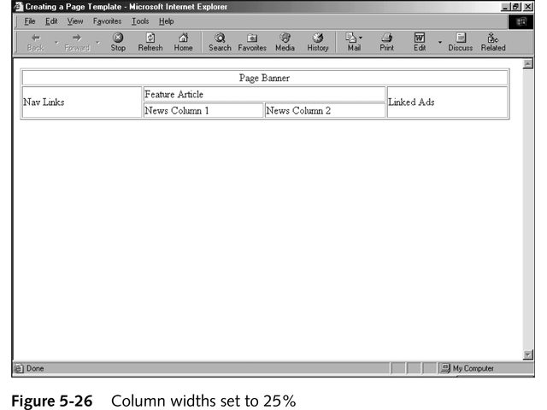
The Output

Slide 93
Frames
Frames are a relatively new addition to the HTML standard. First introduced in Netscape Navigator 2.0.
Objectives:
Upon completing this section, you should be able to:
Create a Frame based page.
Work with the Frameset, Frame, and Noframes elements.
Use the attributes of the Frames elements to control the display.
Set Targets appropriately.

Slide 94
Frames
A framed page is actually made up of multiple HTML pages. There is one HTML document that describes how to break up the single browser window into multiple windowpanes. Each windowpane is filled with an HTML document.
For Example to make a framed page with a windowpane on the left and one on the right requires three HTML pages. Doc1.html and Doc2.html are the pages that contain content. Frames.html is the page that describes the division of the single browser window into two windowpanes.

Slide 95
Frames
Doc1.html
Doc2.html
Doc1.html
Doc2.html
Frames.html

Slide 96
Frame Page Architecture
A <FRAMESET> element is placed in the html document before the <BODY> element. The <FRAMESET> describes the amount of screen real estate given to each windowpane by dividing the screen into ROWS or COLS.
The <FRAMESET> will then contain <FRAME> elements, one per division of the browser window.
Note: Because there is no BODY container, FRAMESET pages can't have background images and background colors associated with them.

Slide 97
Frame Page Architecture
<HTML>
<HEAD>
<TITLE> Framed Page </TITLE>
<FRAMeSET COLS=“23%,77%”>
<FRAME SRC=“Doc1.html”>
<FRAME SRC=“Doc2.html”>
</FRAMeSET >
</HEAD>
</HTML>

Slide 98
The Diagram below is a graphical view of the document described above
FRAMESET COLS=”23%, 77%”
FRAME
NAME= left_pane
SRC=Doc1.html
FRAME
NAME=right_pane
SRC= Doc2.html

Slide 99
<FRAMESET> Container
<FRAMESET> : The FRAMESET element creates divisions in the browser window in a single direction. This allows you to define divisions as either rows or columns.
ROWS : Determines the size and number of rectangular rows within a <FRAMESET>. They are set from top of the display area to the bottom.
Possible values are:
Absolute pixel units, I.e. “360,120”.
A percentage of screen height, e.g. “75%,25%”.
Proportional values using the asterisk (*). This is often combined with a value in pixels , e.g. “360,*”.
<Frameset cols=“200,20%,*,2*”>

Slide 100
Creating a Frames Page
COLS: Determines the size and number of rectangular columns within a <FRAMESET>. They are set from left to right of the display area.
Possible values are:
Absolute pixel units, I.e. “480,160”.
A percentage of screen width, e.g. “75%,25%”.
Proportional values using the asterisk (*). This is often combined with a value in pixels , e.g. “480,*”.

Slide 101
Creating a Frames Page
FRAMEBORDER : Possible values 0, 1, YES, NO. A setting of zero will create a borderless frame.
FRAMESPACING: This attribute is specified in pixels. If you go to borderless frames you will need to set this value to zero as well, or you will have a gap between your frames where the border used to be.
BORDER(thickness of the Frame): This attribute specified in pixels. A setting of zero will create a borderless frame. Default value is 5.
BORDERCOLOR: This attribute allows you choose a color for your border. This attribute is rarely used.

Slide 102
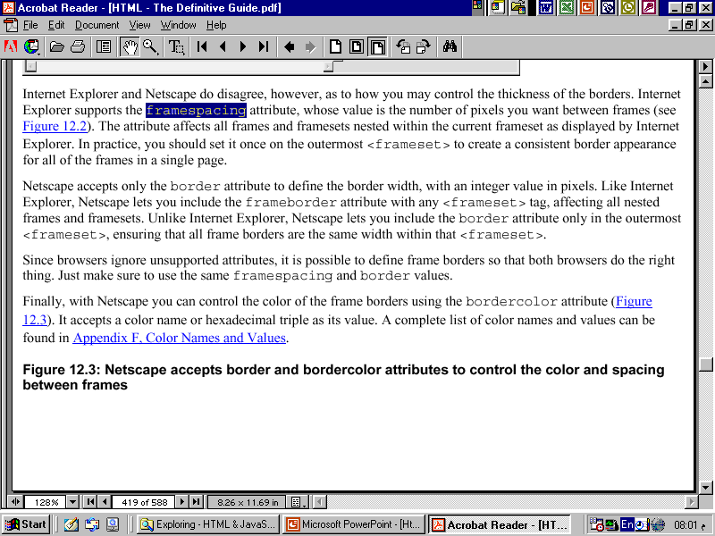

Slide 103
<FRAME>
<FRAME>: This element defines a single frame within a frameset. There will be a FRAME element for each division created by the FRAMESET element. This tag has the following attributes:
SRC: Required, as it provides the URL for the page that will be displayed in the frame.
NAME: Required for frames that will allow targeting by other HTML documents. Works in conjunction with the target attribute of the <A>, <AREA>, <BASE>, and <FORM> tags.

Slide 104
<FRAME>
MARGINWIDTH: Optional attribute stated in pixels. Determines horizontal space between the <FRAME> contents and the frame’s borders.
MARGINHEIGHT: Optional attribute stated in pixels. Determines vertical space between the <FRAME> contents and the frame’s borders.
SCROLLING: Displays a scroll bar(s) in the frame. Possible values are:
Yes – always display scroll bar(s).
No – never display scroll bar(s).
Auto – browser will decide based on frame contents.
By default: scrolling is auto.

Slide 105
<FRAME>
NORESIZE: Optional – prevents viewers from resizing the frame. By default the user can stretch or shrink the frame’s display by selecting the frame’s border and moving it up, down, left, or right.

Slide 106
<NOFRAMES>
<NOFRAMES>: Frame – capable browsers ignore all HTML within this tag including the contents of the BODY element. This element does not have any attributes.
<HTML>
<HEAD>
<TITLE> Framed Page </TITLE>
</HEAD>

Slide 107
<NOFRAMES>
<FRAMESET COLS="23%,77%">
<FRAME SRC="" NAME="left_pane“>
<FRAME SRC="" NAME="right_pane">
<NOFRAMES>
<P> This is a Framed Page. Upgrade your browser to support frames.</P>
</NOFRAMES></FRAMESET>

Slide 108
Compound FRAMESET Divisions
In this case a second FRAMESET element will be inserted in the place of the FRAME element that would describe the second row.
The second FRAMESET element will divide the remaining screen real estate into 2 columns.
This nested FRAMESET will then be followed by 2 FRAME elements to describe each of the subsequent frame divisions created.

Slide 109
Compound FRAMESET Divisions
<html>
<head>
<title> Compound Frames Page</title>
</head>
<frameset rows=“120,*”>
<frame src=“banner_file.html” name”banner”>
<frameset cols=“120,*”>
<frame src=“links_file.html” name=“links”>
<frame src=“content_file.html” name=“content”>
<noframes>
<p>
Default message
</p>
</noframes>
</frameset>
</frameset>
</head>

Slide 110
Compound FRAMESET Divisions You may want to create a frames design with a combination of rows and columns.
Banner File
Links
File
Contents File

Slide 111
Compound FRAMESET Divisions Example
<HEAD>
<FRAMESET ROWS="25%,50%,25%”
<FRAME SRC="">
<FRAMESET COLS="25%,*">
<FRAME SRC="">
<FRAME SRC="">
</FRAMESET>
<FRAME SRC="">
</FRAMESET>
</HEAD>

Slide 112
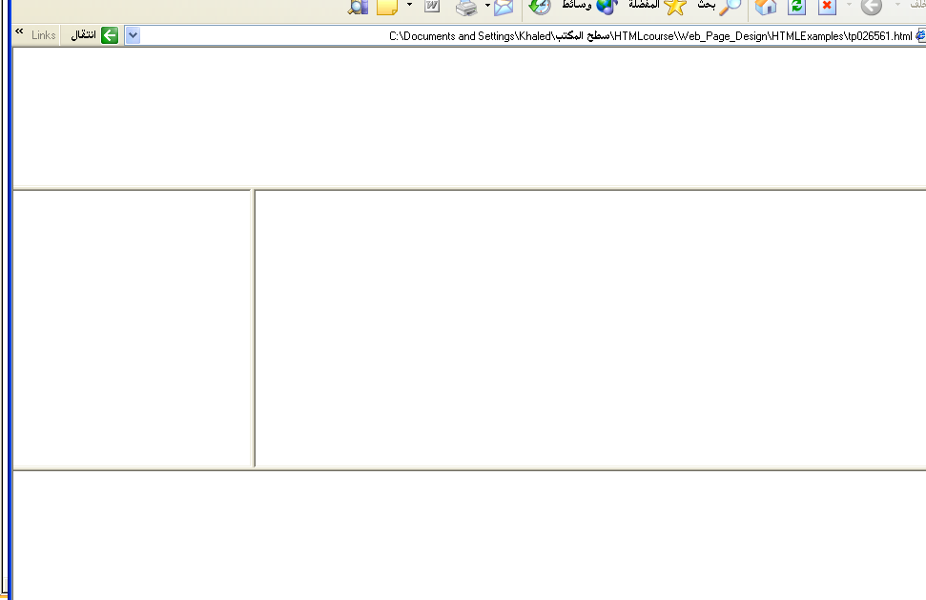
Output

Slide 113
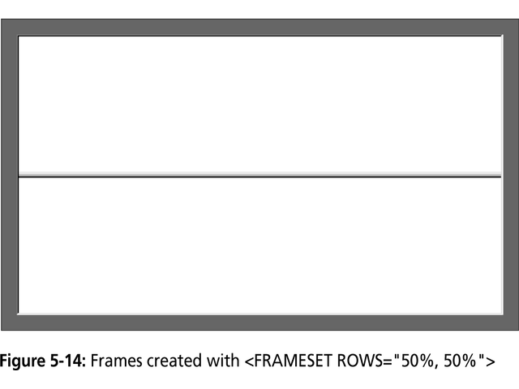

Slide 114
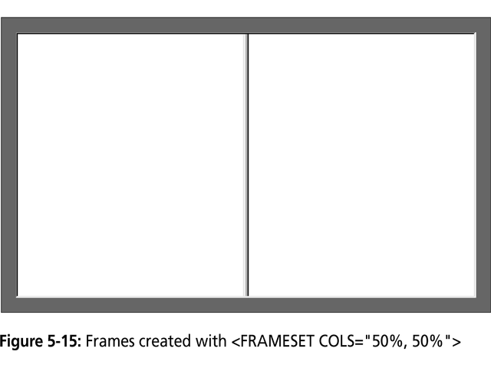

Slide 115
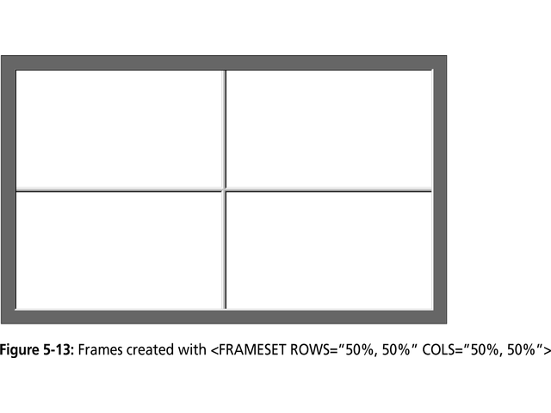

Slide 116
Frame Formatting
Example:
<frameset rows=“20%, *, 20%”>
<frame src=“header.html” noresize scrolling=no>
<frame src=“body.html”>
<frame src=“navigationbar.html” noresize scrolling=no>
</frameset>

Slide 117
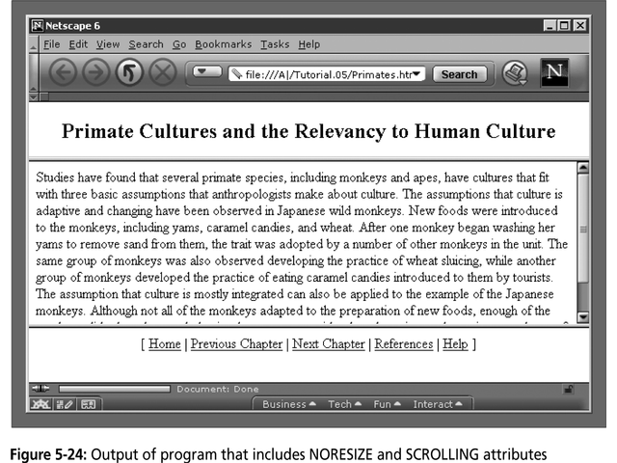

Slide 118
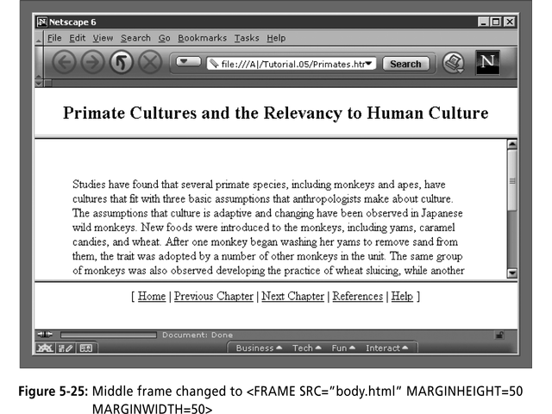

Slide 119
What do the following mean?
<FRAMESET COLS="2*, 3*, 5*">
2) <FRAMESET COLS="150, 20%, *, 3*">
So what are the space-allocation priorities? Absolute pixel values are always assigned space first, in order from left to right. These are followed by percentage values of the total space. Finally, proportional values are divided based upon what space is left.

Slide 120
Generic Frame Formula
The <FRAME> tag has six associated attributes: SRC, NAME, MARGINWIDTH, MARGINHEIGHT, SCROLLING, and NORESIZE. Here's a complete generic FRAME:
<FRAME SRC="url" NAME="window_name" SCROLLING=YES|NO|AUTO MARGINWIDTH="value" MARGINHEIGHT="value"
NORESIZE>

Slide 121
What will be the Output?
<FRAMESET ROWS="*, 2*, *" COLS="2*, *">
<FRAME NAME=“A1” SRC=“a1.html”>
<FRAME SRC=“a2.html”>
<FRAME SRC=“”>
<FRAME SRC=“”>
<FRAME SRC=“”>
<FRAME SRC=“”>
</FRAMESET>

Slide 122
Targets
When you use links for use in a frames environment you will need to specify an additional attribute called TARGET.
The TARGET attribute uses the NAME attribute of the FRAME element.
If we were to place a link in doc1.html that linked to doc3.html and we wanted doc3.html to be displayed in the right windowpane; the HTML code would appear in doc1.html as follows:
<A HREF=“doc3.html” TARGET=“right_pane”>Link to Document 3 </A>

Slide 123
Special Targets
There are 4 special target names that cannot be assigned by the NAME attribute of the FRAME tag.
1. TARGET=“_top” : This loads the linked document into the full browser window with the URL specified by the HREF attribute. All frames disappear, leaving the new linked page to occupy the entire window. The back is turned on.
2. TARGET=“_blank” : Opens an unnamed new browser window and loads the document specified in the URL attribute into the new window (and your old window stays open). The back is turned off. Other windows remains on.
3. TARGET=“_self” : Loads the document in the same window where the anchor was {Clicked}. This is the default setting for linking elements.
4. TARGET=“_parent” : the _parent frame is a prior frameset that the current frameset was “spawned” from. If there isn’t one it is the browser window. The document is loaded into the area occupied by the columns or rows frameset containing the frame that contains the link. The back is turned on. All windows disappear.

Slide 124
If a frame contains the following link, then clicking the link launches a new, unnamed browser display window that contains the content defined in stuff.HTM. This can be a simple HTML document, or an entirely new FRAMESET definition.
1. <A HREF="stuff.html" TARGET="_blank">
If a frame contains the following link, then clicking the link will simply cause the frame which contains the link to clear, and its content will be replaced with whatever is in stuff.htm.
2. <A HREF="stuff.html" TARGET="_self">
If a frame contains the following link, the frameset that contains the frame that contains this link will be replaced by stuff.HTM.
3. <A HREF="stuff.html" TARGET="_parent">
Finally, if a frame contains the following link, clicking the link replaces the entire browser window with the contents of stuff.HTM.
4. <A HREF="stuff.html" TARGET="_top">

Slide 125
Targeting links to frames
The TARGET attribute allows you to specify the frame into which a page is to be loaded into in a frames setting.
<A HREF=“chap1.html” TARGET=“_self”> [Chapter 1]</A>
<A HREF=“chap1.html” TARGET=“_parent”> [Chapter 2]</A>
Parent window
chap1.html
Learning HTML
[Chapter 1][Chapter 2][Chapter 3]
chap2.html

Slide 126
Targeting links to frames
The TARGET attribute allows you to specify the frame into which a page is to be loaded into in a frames setting.
<A HREF=“chap1.html” TARGET=“bottom”> [Chapter 1]</A>
<A HREF=“chap2.html” TARGET=“bottom”> [Chapter 2]</A>
<A HREF=“chap3.html” TARGET=“bottom”> [Chapter 3]</A>
chap1.html
Learning HTML
[Chapter 1][Chapter 2][Chapter 3]
chap2.html
chap3.html

Slide 127
Forms
Forms add the ability to web pages to not only provide the person viewing the document with dynamic information but also to obtain information from the person viewing it, and process the information.
Objectives:
Upon completing this section, you should be able to
Create a FORM.
Add elements to a FORM.
Define CGI (Common Gateway Interface).
Describe the purpose of a CGI Application.
Specify an action for the FORM.
Forms work in all browsers.
Forms are Platform Independent.

Slide 128
Forms
To insert a form we use the <FORM></FORM> tags. The rest of the form elements must be inserted in between the form tags.
<HTML> <HEAD>
<TITLE> Sample Form</TITLE>
</HEAD>
<BODY BGCOLOR=“FFFFFF”>
<FORM ACTION = http://www.xnu.com/formtest.asp>
<P> First Name: <INPUT TYPE=“TEXT” NAME=“fname” MAXLENGTH=“50”> </P>
<P> <INPUT TYPE=“SUBMIT” NAME=“fsubmit1” VALUE=“Send Info”> </P>
</FORM>
</BODY> </HTML>

Slide 129
<FORM> element attributes
ACTION: is the URL of the CGI (Common Gateway Interface) program that is going to accept the data from the form, process it, and send a response back to the browser.
METHOD: GET (default) or POST specifies which HTTP method will be used to send the form’s contents to the web server. The CGI application should be written to accept the data from either method.
NAME: is a form name used by VBScript or
JavaScripts.
TARGET: is the target frame where the response page will show up.

Slide 130
Form Elements
Form elements have properties: Text boxes, Password boxes, Checkboxes, Option(Radio) buttons, Submit, Reset, File, Hidden and Image.
The properties are specified in the TYPE Attribute of the HTML element <INPUT></INPUT>.

Slide 131
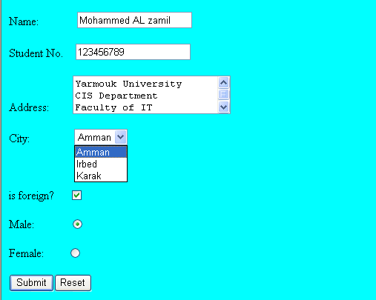
Sami Ali
Al al-Bayt University

Slide 132
Form Elements
<INPUT> Element’s Properties
TYPE= Type of INPUT entry field.
NAME = Variable name passed to CGI application
VALUE= The data associated with the variable name to be passed to the CGI application
CHECKED= Button/box checked
SIZE= Number of visible characters in text field
MAXLENGHT= Maximum number of characters accepted.

Slide 133

Text Box
Text boxes: Used to provide input fields for text, phone numbers, dates, etc.
<INPUT TYPE= " TEXT " >
Browser will display
Textboxes use the following attributes:
TYPE: text.
SIZE: determines the size of the textbox in characters. Default=20 characters.
MAXLENGHT : determines the maximum number of characters that the field will accept.
NAME: is the name of the variable to be sent to the CGI application.
VALUE: will display its contents as the default value.

Slide 134
Example on Text Box
<TITLE>Form_Text_Type</TITLE>
</HEAD> <BODY>
<h1> <font color=blue>Please enter the following bioData</font></h1>
<FORM name="fome1" Method= " get " Action= " URL " >
First Name: <INPUT TYPE="TEXT" NAME="FName"
SIZE="15" MAXLENGTH="25"><BR>
Last Name: <INPUT TYPE="TEXT" NAME="LName"
SIZE="15" MAXLENGTH="25"><BR>
Nationality: <INPUT TYPE="TEXT" NAME="Country"
SIZE="25" MAXLENGTH="25"><BR>
The Phone Number: <INPUT TYPE="TEXT" NAME="Phone"
SIZE="15" MAXLENGTH="12"><BR>
</FORM> </BODY> </HTML>

Slide 135
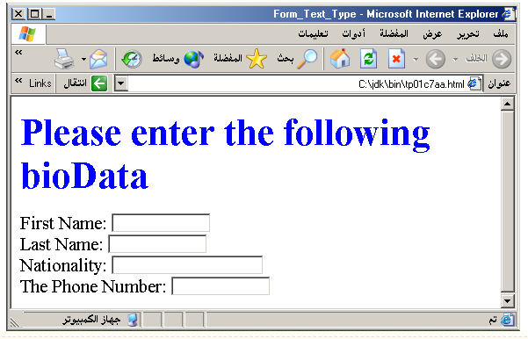
Output

Slide 136
Password
Password: Used to allow entry of passwords.
<INPUT TYPE= " PASSWORD " >
Browser will display
Text typed in a password box is starred out in the browser
display.
Password boxes use the following attributes:
TYPE: password.
SIZE: determines the size of the textbox in characters.
MAXLENGHT: determines the maximum size of the password in characters.
NAME: is the name of the variable to be sent to the CGI application.
VALUE: is usually blank.

Slide 137
Example on Password Box
<HTML><HEAD>
<TITLE>Form_Password_Type</TITLE></HEAD>
<BODY>
<h1> <font color=red>To Access, Please
enter:</font></h1>
<FORM name="fome2" Action="url" method="get">
User Name: <INPUT TYPE="TEXT" Name="FName"
SIZE="15" MAXLENGTH="25"><BR>
Password: <INPUT TYPE="PASSWORD"
NAME="PWord" value="" SIZE="15”
MAXLENGTH="25"><BR>
</FORM></BODY> </HTML>

Slide 138
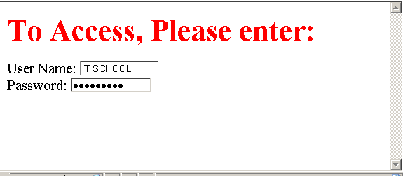
Output

Slide 139
Hidden
Hidden: Used to send data to the CGI application that you don’t want the web surfer to see, change or have to enter but is necessary for the application to process the form correctly.
<INPUT TYPE=“HIDDEN”>
Nothing is displayed in the browser.
Hidden inputs have the following attributes:
TYPE: hidden.
NAME: is the name of the variable to be sent to the CGI application.
VALUE: is usually set a value expected by the CGI application.

Slide 140
Check Box
Check Box: Check boxes allow the users to select more than one option.
<INPUT TYPE=“CHECKBOX”>
Browser will display
Checkboxes have the following attributes:
TYPE: checkbox.
CHECKED: is blank or CHECKED as the initial
status.
NAME: is the name of the variable to be sent to the
CGI application.
VALUE: is usually set to a value.

Slide 141
<HTML> <HEAD><TITLE>CheckBoxType</TITLE> </HEAD>
<BODY>
<h1> <font color=green>Please check one of the following</font></h1>
<FORM name="fome3" Action="url" method="get">
<font color=red> Select Country: </font><BR>
jordan:<INPUT TYPE="CheckBox" Name="country" CHECKED><BR>
Yemen<INPUT TYPE="CheckBox" Name="country"><BR>
Qatar:<INPUT TYPE="CheckBox" Name="country"><BR> <BR>
<font color=blue>Select Language:</font><BR>
Arabic:<INPUT TYPE="CheckBox" Name="language" CHECKED><BR> English:<INPUT TYPE="CheckBox" Name="language"><BR>
French:<INPUT TYPE="CheckBox" Name="language"> <BR></FORM> </BODY></HTML>

Slide 142
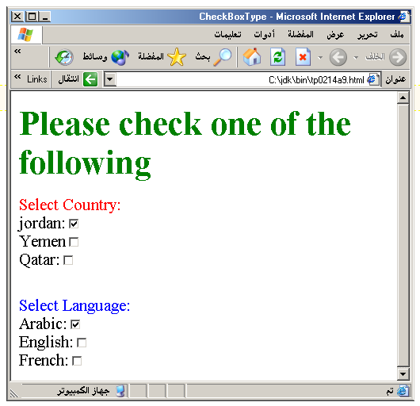
Output

Slide 143
Radio Button
Radio Button: Radio buttons allow the users to select
only one option.
<INPUT TYPE=“RADIO”>
Browser will display
Radio buttons have the following attributes:
TYPE: radio.
CHECKED: is blank or CHECKED as the initial
status. Only one radio button can be
checked
NAME: is the name of the variable to be sent to the
CGI application.
VALUE: usually has a set value.

Slide 144
<HTML> <HEAD><TITLE>CheckBoxType</TITLE> </HEAD>
<BODY>
<h1> <font color=green>Please check one of the following</font></h1>
<FORM name="fome3" Action="url" method="get">
<font color=red> Select Country: </font><BR>
jordan:<INPUT TYPE= "RADIO" Name="country" CHECKED><BR>
Yemen<INPUT TYPE="RADIO " Name="country"><BR>
Qatar:<INPUT TYPE="RADIO" Name="country"><BR> <BR>
<font color=blue>Select Language:</font><BR>
Arabic:<INPUT TYPE="RADIO" Name="language" CHECKED><BR> English:<INPUT TYPE=" RADIO " Name="language"><BR>
French:<INPUT TYPE=" RADIO " Name="language"> <BR></FORM> </BODY></HTML>

Slide 145
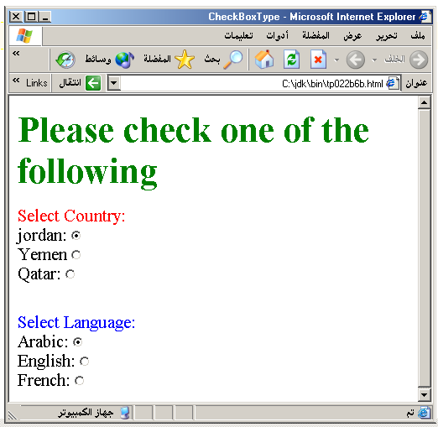

Slide 146
<HTML><HEAD>
<TITLE>RADIOBox</TITLE> </HEAD>
<BODY>
Form #1:
<FORM>
<INPUT TYPE="radio" NAME="choice" VALUE="one"> Yes.
<INPUT TYPE="radio" NAME="choice" VALUE="two"> No.
</FORM>
<HR color=red size="10" >
Form #2:
<FORM>
<INPUT TYPE="radio" NAME="choice" VALUE="three" CHECKED> Yes.
<INPUT TYPE="radio" NAME="choice" VALUE="four"> No.
</FORM>
</BODY></HTML>

Slide 147
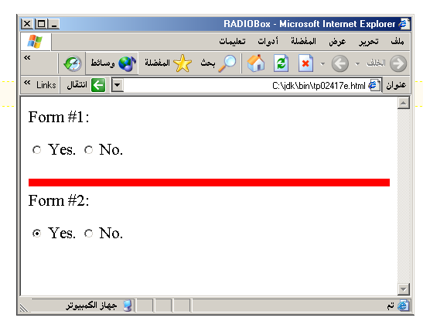
Output

Slide 148
Push Button
Push Button: This element would be used with
JavaScript to cause an action to take place.
<INPUT TYPE=“BUTTON”>
Browser will display
Push Button has the following attributes:
TYPE: button.
NAME: is the name of the button to be used
in scripting.
VALUE: determines the text label on the button.

Slide 149
<DIV align=center><BR><BR>
<FORM>
<FONT Color=red>
<h1>Press Here to see a baby crying:<BR>
<INPUT TYPE="button" VALUE="PressMe"><BR><BR>
<FONT Color=blue>
Click Here to see a baby shouting:<BR>
<INPUT TYPE="button" VALUE="ClickMe" > <BR><BR>
<FONT Color=green>
Hit Here to see a baby eating:<BR>
<INPUT TYPE="button" VALUE="HitME" > <BR><BR>
<FONT Color=yellow>
</FORM></DIV>

Slide 150
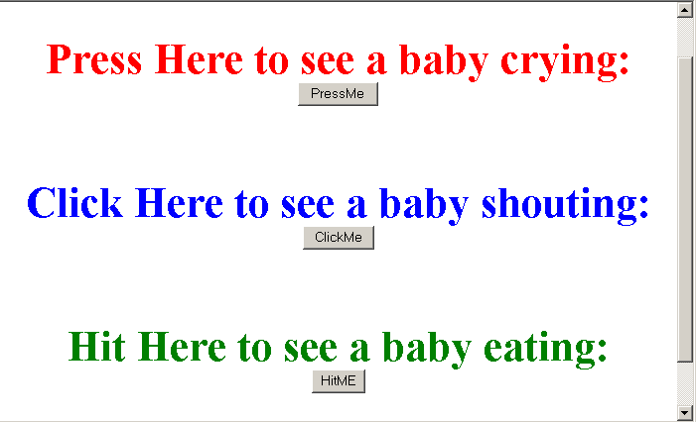

Slide 151
Submit Button
Submit: Every set of Form tags requires a Submit button. This is the element causes the browser to send the names and values of the other elements to the CGI Application specified by the ACTION attribute of the FORM element.
<INPUT TYPE=“SUBMIT”>
The browser will display
Submit has the following attributes:
TYPE: submit.
NAME: value used by the CGI script for processing.
VALUE: determines the text label on the button, usually Submit Query.

Slide 152
<FORM Action="URL" method="get">
First Name: <INPUT TYPE="TEXT" Size=25 name="firstName"><BR>
Family Name: <INPUT TYPE="TEXT" Size=25 name="LastName"><BR>
<BR>
<FONT Color=red>
Press Here to submit the data:<BR>
<INPUT TYPE="submit" VALUE="SubmitData " >
</FORM>

Slide 153
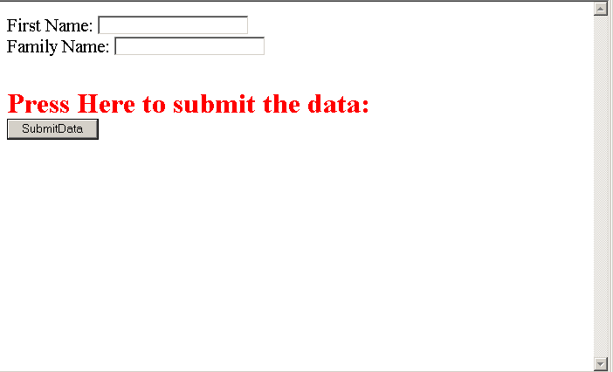

Slide 154
Reset Button
Reset: It is a good idea to include one of these for each form where users are entering data. It allows the surfer to clear all the input in the form.
<INPUT TYPE=“RESET”>
Browser will display
Reset buttons have the following attributes:
TYPE: reset.
VALUE: determines the text label on the button, usually Reset.

Slide 155
<FORM Action="URL" method="get">
First Name: <INPUT TYPE="TEXT" Size=25 name="firstName"> <BR>
Family Name: <INPUT TYPE="TEXT" Size=25 name="LastName"><BR>
<BR>
<FONT Color = red>
<STRONG><font size=5>Press Here to submit the data:</font></STRONG><BR>
<INPUT TYPE="submit" VALUE="SubmitData">
<INPUT TYPE="RESET" VALUE="Reset">
</FORM>

Slide 156
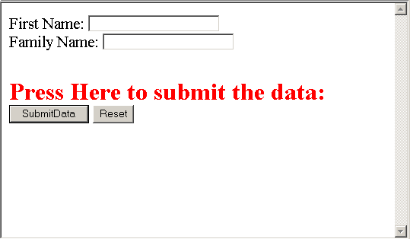

Slide 157
Image Submit Button
Image Submit Button: Allows you to substitute an image for the standard submit button.
<INPUT TYPE=“IMAGE” SRC=“jordan.gif”>
Image submit button has the following attributes:
TYPE: Image.
NAME: is the name of the button to be used in scripting.
SRC: URL of the Image file.

Slide 158
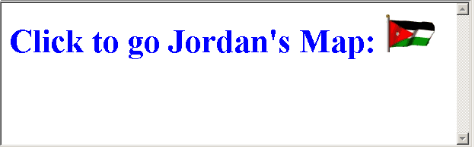
<form> <H1><font color=blue> Click to go Jordan’s Map: <INPUT TYPE="IMAGE" SRC="jordan.gif"> </form>

Slide 159

File
File Upload: You can use a file upload to allow surfers to upload files to your web server.
<INPUT TYPE=“FILE”>
Browser will display
File Upload has the following attributes:
TYPE: file.
SIZE: is the size of the text box in characters.
NAME: is the name of the variable to be sent to the
CGI application.
MAXLENGHT: is the maximum size of the input in the
textbox in characters.

Slide 160
<BODY bgcolor=lightblue>
<form>
<H3><font color=forestgreen>
Please attach your file here to for uploading to
My <font color =red>SERVER...<BR>
<INPUT TYPE="File" name="myFile" size="30">
<INPUT TYPE="Submit" value="SubmitFile">
</form>
</BODY>

Slide 161
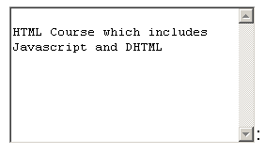
Other Elements used in Forms
<TEXTAREA></TEXTAREA>: is an element that allows for free form text entry.
Browser will display
Textarea has the following attributes:
NAME: is the name of the variable to be sent to the CGI application.
ROWS: the number of rows to the textbox.
COLS: the number of columns to the textbox.

Slide 162
<BODY bgcolor=lightblue>
<form>
<TEXTAREA COLS=40 ROWS=20 Name="comments" >
From observing the apathy of those
about me during flag raising I
concluded that patriotism if not
actually on the decline is at least
in a state of dormancy.
Written by Khaled Al-Fagih
</TEXTAREA>:
</form>
</BODY>

Slide 163
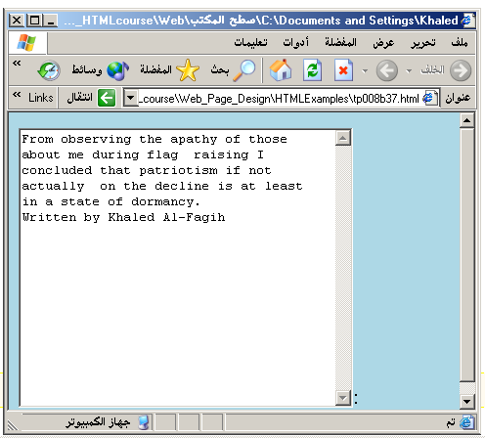

Slide 164
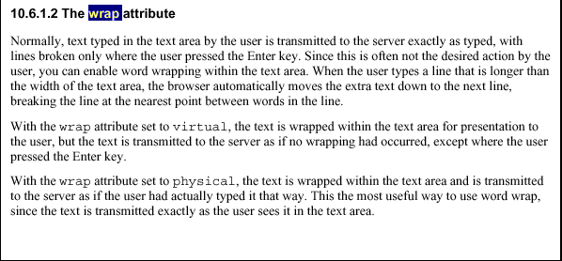

Slide 165

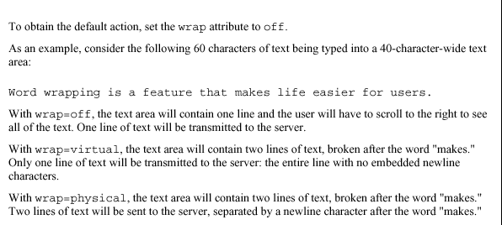


Slide 166
Other Elements used in Forms
The two following examples are <SELECT></SELECT> elements, where the attributes are set differently.
The Select elements attributes are:
NAME: is the name of the variable to be sent to the CGI application.
SIZE: this sets the number of visible choices.
MULTIPLE: the presence of this attribute signifies that the user can make multiple selections. By default only one selection is allowed.

Slide 167
<BODY bgcolor=lightblue>
<form>
Select the cities you have visited:
<SELECT name=“list” size=5>
<option> London</option>
<option> Tokyo</option>
<option> Paris</option>
<option> New York</option>
<option> LA</option>
<option> KL</option>
</SELECT>
</form>
</BODY>

Slide 168
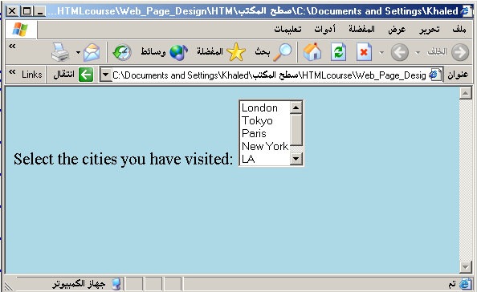

Slide 169
Other Elements used in Forms
Drop Down List:
Name: is the name of the variable to be sent to the CGI application.
Size: 1.

Slide 170

Other Elements used in Forms
List Box:
Name: is the name of the variable to be sent to the CGI application.
SIZE: is greater than one.

Slide 171
Other Elements used in Forms
Option
The list items are added to the <SELECT> element by inserting <OPTION></OPTION> elements.
The Option Element’s attributes are:
SELECTED: When this attribute is present, the option is selected when the document is initially loaded. It is an error for more than one option to be selected.
VALUE: Specifies the value the variable named in the select element.

Slide 172
</HEAD>
<BODY>
<h2><font color=blue>What type of Computer do you have?</font><h2>
<FORM>
<SELECT NAME="ComputerType" size=4>
<OPTION value="IBM" SELECTED> IBM</OPTION>
<OPTION value="INTEL"> INTEL</OPTION>
<OPTION value=" Apple"> Apple</OPTION>
<OPTION value="Compaq"> Compaq</OPTION>
</SELECT>
</FORM></BODY></HTML>

Slide 173
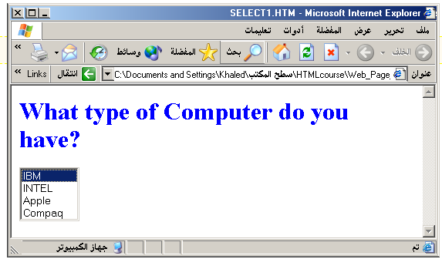

Slide 174
<HEAD> <TITLE>SELECT with Mutiple </TITLE> </HEAD>
<BODY>
<h2><font color=blue>What type of Computer do you have?</font><h2>
<FORM>
<SELECT NAME="ComputerType" size=5 multiple>
<OPTION value="IBM" > IBM</OPTION>
<OPTION value="INTEL"> INTEL</OPTION>
<OPTION value=" Apple"> Apple</OPTION>
<OPTION value="Compaq" SELECTED> Compaq</OPTION>
<OPTION value=" other"> Other</OPTION>
</SELECT>
</FORM></BODY></HTML>

Slide 175
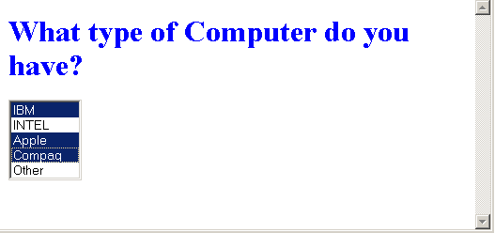

Slide 176
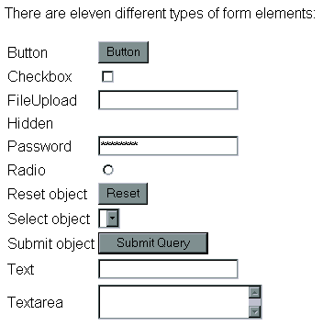

Slide 177
media element tags introduced by HTML5
HTML5 introduced 5 most popular media element tags i.e. <audio>, <video>, <source>, <embed>, <track>. This media element tags changed the entire development using HTML.

Slide 178
Media Tags:
<audio>: It is an inline element that is used to embed sound files into a web page.
<video>: It is used to embed video files into a web page.
<source>: It is used to attach multimedia files like audio, video, and pictures.
<embed>: It is used for embedding external applications which are generally multimedia content like audio or video into an HTML document.
<track>: It specifies text tracks for media components audio and video.

Slide 179
Advantage of Media tag:
Plugins are no longer required
Speed – anything naturally integrated into a browser will be rendered and executed in a faster fashion than imported third-party
Native (built-in) controls are provided by the browser.
Accessibilities (keyboard, mouse) are built-in automatically

Slide 180
<audio> Tag
It is a useful tag if you want to add audio such as songs, or any sound files into your webpage.
Syntax:
<audio controls autoplay >
<source src="sample.mp3" type="audio/mpeg">
</audio>

Slide 181
<video> tag
It is a standard way to embed a video into your web page.
Syntax:
<video width=“400” height=“300” controls preload>
<source src="sample.mp4" type=“video/mp4">
</video>

Slide 182
<embed> tag
It is used as a container for embedding plug-ins such as flash animations.
<embed src=“sample.gif“ width="300px" height="300px">

Slide 183
<source> tag
As you can observe that <audio>, <video> elements contain the <source> element, the <source> tag is used to attach multimedia files.
Syntax:
<source src="" type="">
...
</source>

Slide 184
<track> tag
It is used to specify subtitles, caption files, or different files containing text, that ought to be visible once the media is taking part in it.
Thus it is a simple sectors for the <audio> and <video> elements.
Syntax:
<track Attribute>

Slide 185
<video width="300" height="300" controls>
<source src="myvid.mp4" type="video/mp4">
<track src=“track.mp4“ kind="subtitle" srclang="en"
label="English">
</video>

